Slide 1

19AIE113 – INTRODUCTION TO ELECTRONICS
Deepthi Sudharsan (CB.EN.U4AIE19022)
Isha Indhu S ((CB.EN.U4AIE19030)
Jayashree O. (CB.EN.U4AIE19031)
Kavya S Kumar(CB.EN.U4AIE19037)
Lakshaya Karthikeyan (CB.EN.U4AIE19039)

Slide 2
Aim
To design a differential amplifier using transistors and use the differential circuit to design a voltage comparator circuit
Simulation platforms for obtained circuit:
MultiSim
TinkerCad
Hardware implementation using ADALM module and ALICE M1K desktop

Slide 3
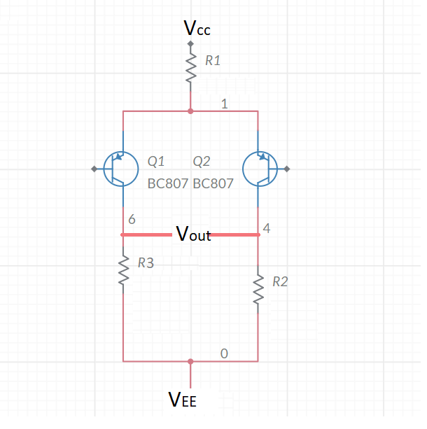
Differential Amplifier
Used to amplify the difference between given inputs
Vout = A(V1-V2)
Implemented using BJTs (Q1 & Q2)
In PNP transistors:
Emitter-Base junction is forward biased
Collector-Base junction is reversed biased
V1
V2

Slide 4
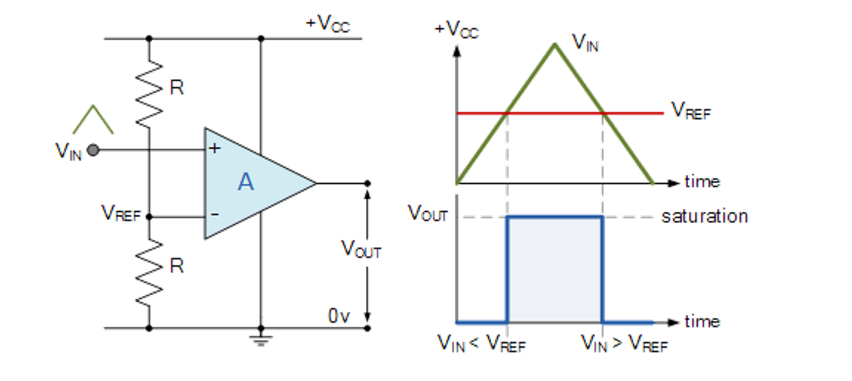
Voltage Comparator using Op-Amps
Inverting input: V_{REF}
Non-inverting input: Vin
When V_{in}<V_{REF}, V_{out} = 0
When V_{in}>V_{REF}, V_{out} = V_{CC}
Notes:
Summarize your research in three to five points.

Slide 5
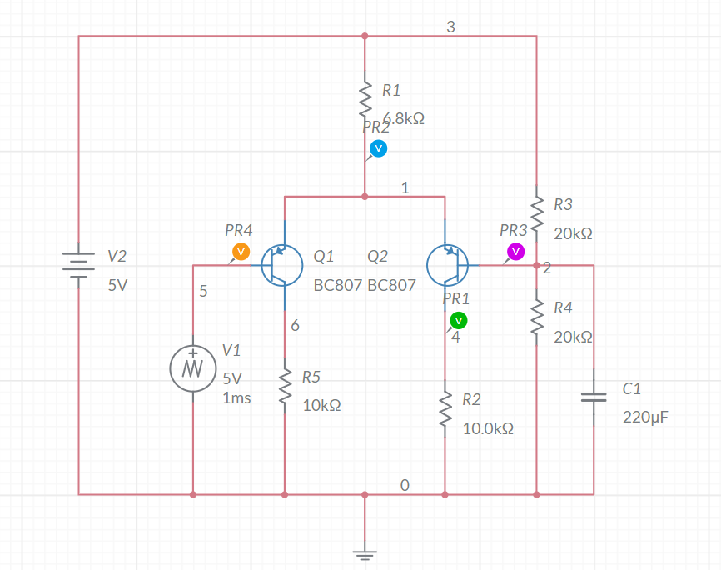
Voltage Comparator using differential amplifier
Components:
Two PNP BJTs
One 5V DC power supply
AC power supply (Triangular 5V)
One 220μF capacitor
Connecting wires
Resistors Required:
Two 20kΩ
Two 10kΩ
One 6.8kΩ

Slide 6
Theory behind the circuit
When V1 < Vref (2.5V): Q1 - Conducts
When V1 > Vref (2.5V): Q2 -Conducts
In a voltage comparator circuit, the expected output is:
When V_{in}<V_{REF}, V_{out} = 0
When V_{in}>V_{REF}, V_{out} = V_{CC}
Hence, voltage is measured at Q2’s collector

Slide 7
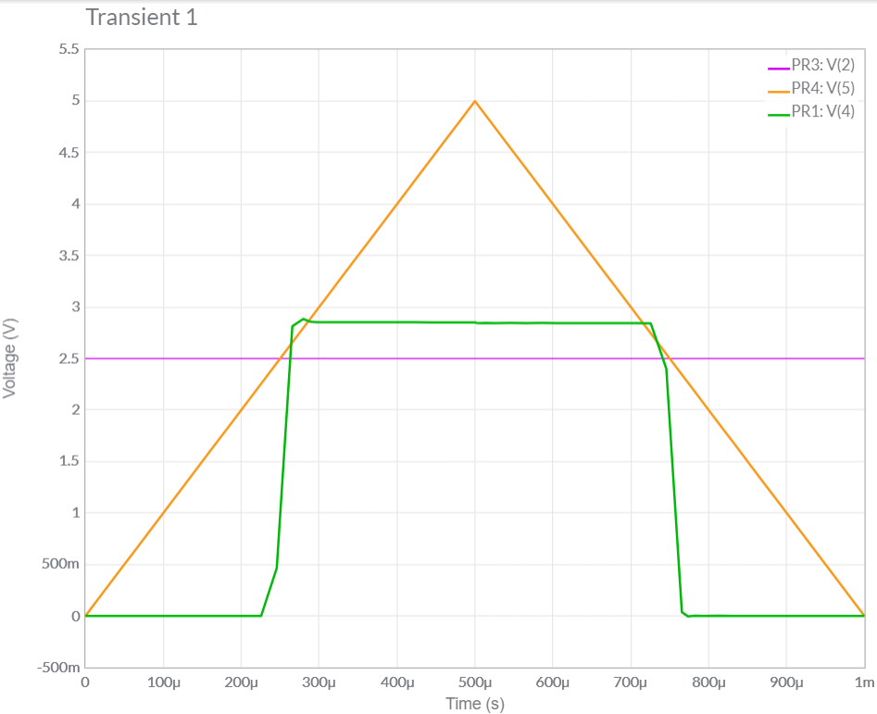
Output using Multisim
Purple (PR3) = Reference Voltage
Orange (PR4) = Input Triangular wave
Green (PR1) = Output

Slide 8
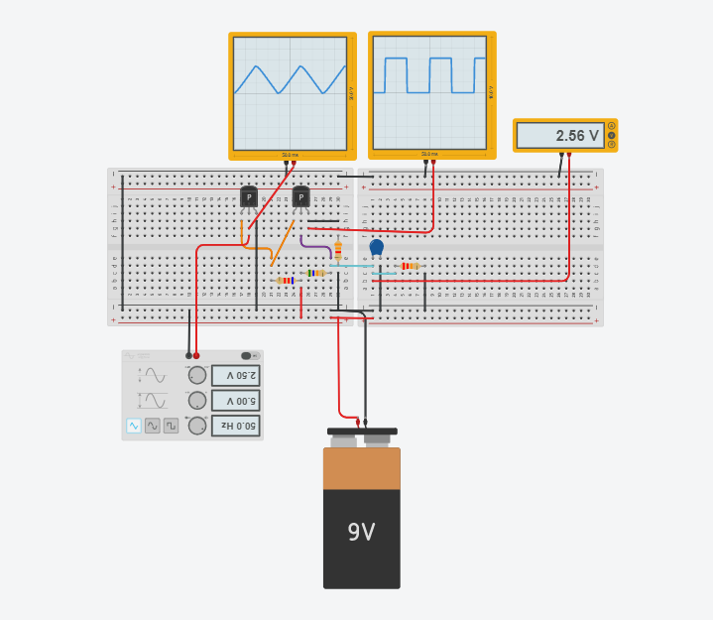
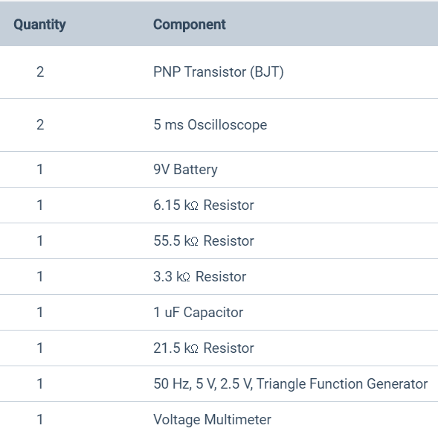
TINKERCAD Implementation
Vref
Input
Output

Slide 9
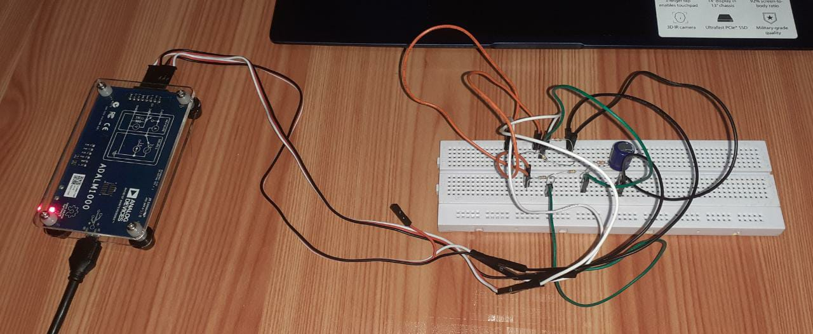
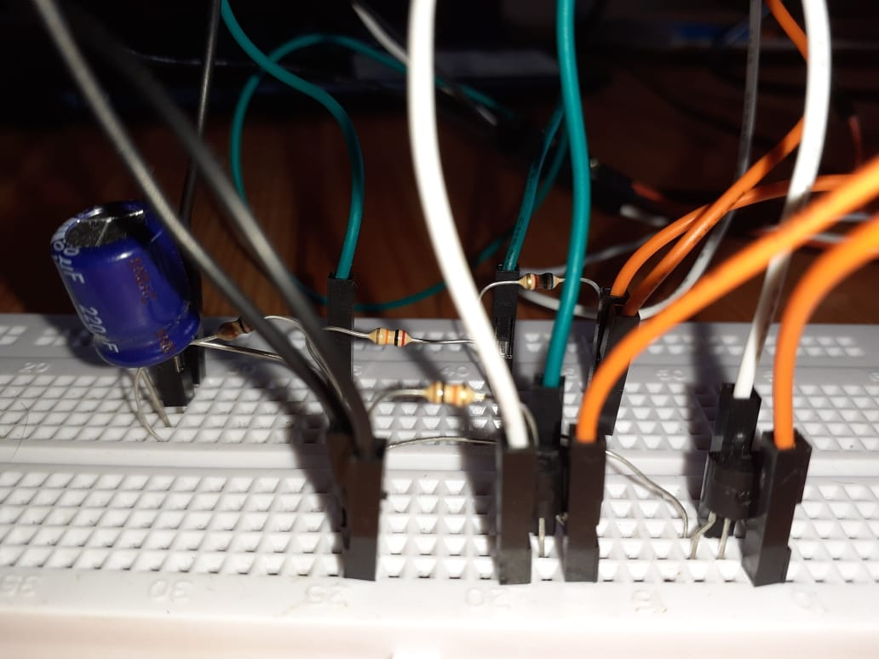
ADALM Implementation

Slide 10
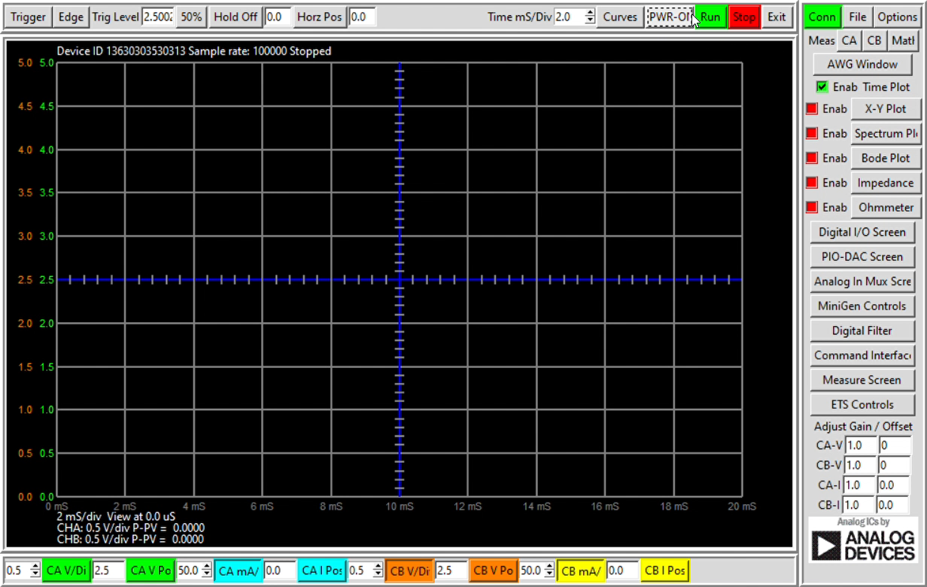
Output using ADALM

Slide 11
Observation Table
Reference voltage (chosen) = 2.5V
CHANNEL A VOLTAGE | CHANNEL B VOLTAGE
3.0V | 2.6861V
2.7V | 2.6842V
2.3V | 0.0078V
1V | 0.0061V

Slide 12
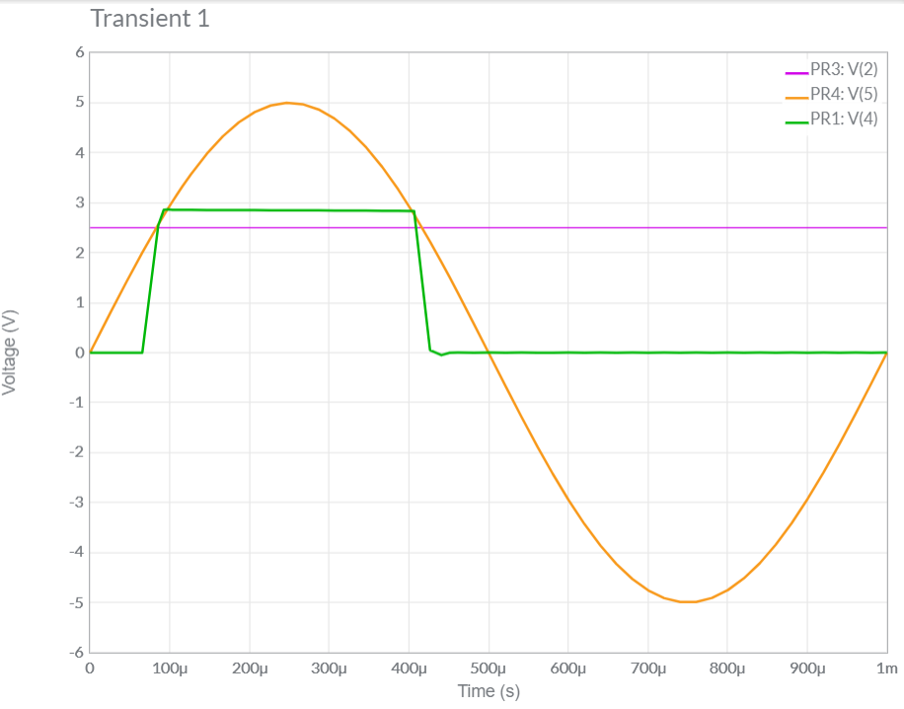
Inference
For any input AC waveform:
Case 1: Vin exceeds 2.5V at any point
The output will always be a square wave
In figure, positive half cycle of sine wave
Case 2: Vin does not exceed 2.5V
The output will be a straight line of 0V
In figure, negative half cycle of sine wave

Slide 13
Limitations of Transistor Circuit
Theoretically, the peak amplitude of the output square wave should be equal to Vcc (V2)
However, due to the voltage drop across the transistors and resistors, the output voltage obtained is less than the expected output voltage
This can be combatted by using MOS transistors.

Slide 14
References
https://www.electrical4u.com/differential-amplifier/
https://www.electronics-tutorials.ws/opamp/opamp_1.html?utm_referrer=https%3A%2F%2Fwww.google.com%2F
https://youtu.be/ehekdOHOIZ0
http://www.circuitstoday.com/op-amps-operational-amplifiers
http://www.bristolwatch.com/ele/vc.htm

